Slide 1
Money Mapper
Café Calligraphists

Slide 2



Why a finance app?
College is expensive
Adulting -> Money Management
Feasible and Expandable

Slide 3
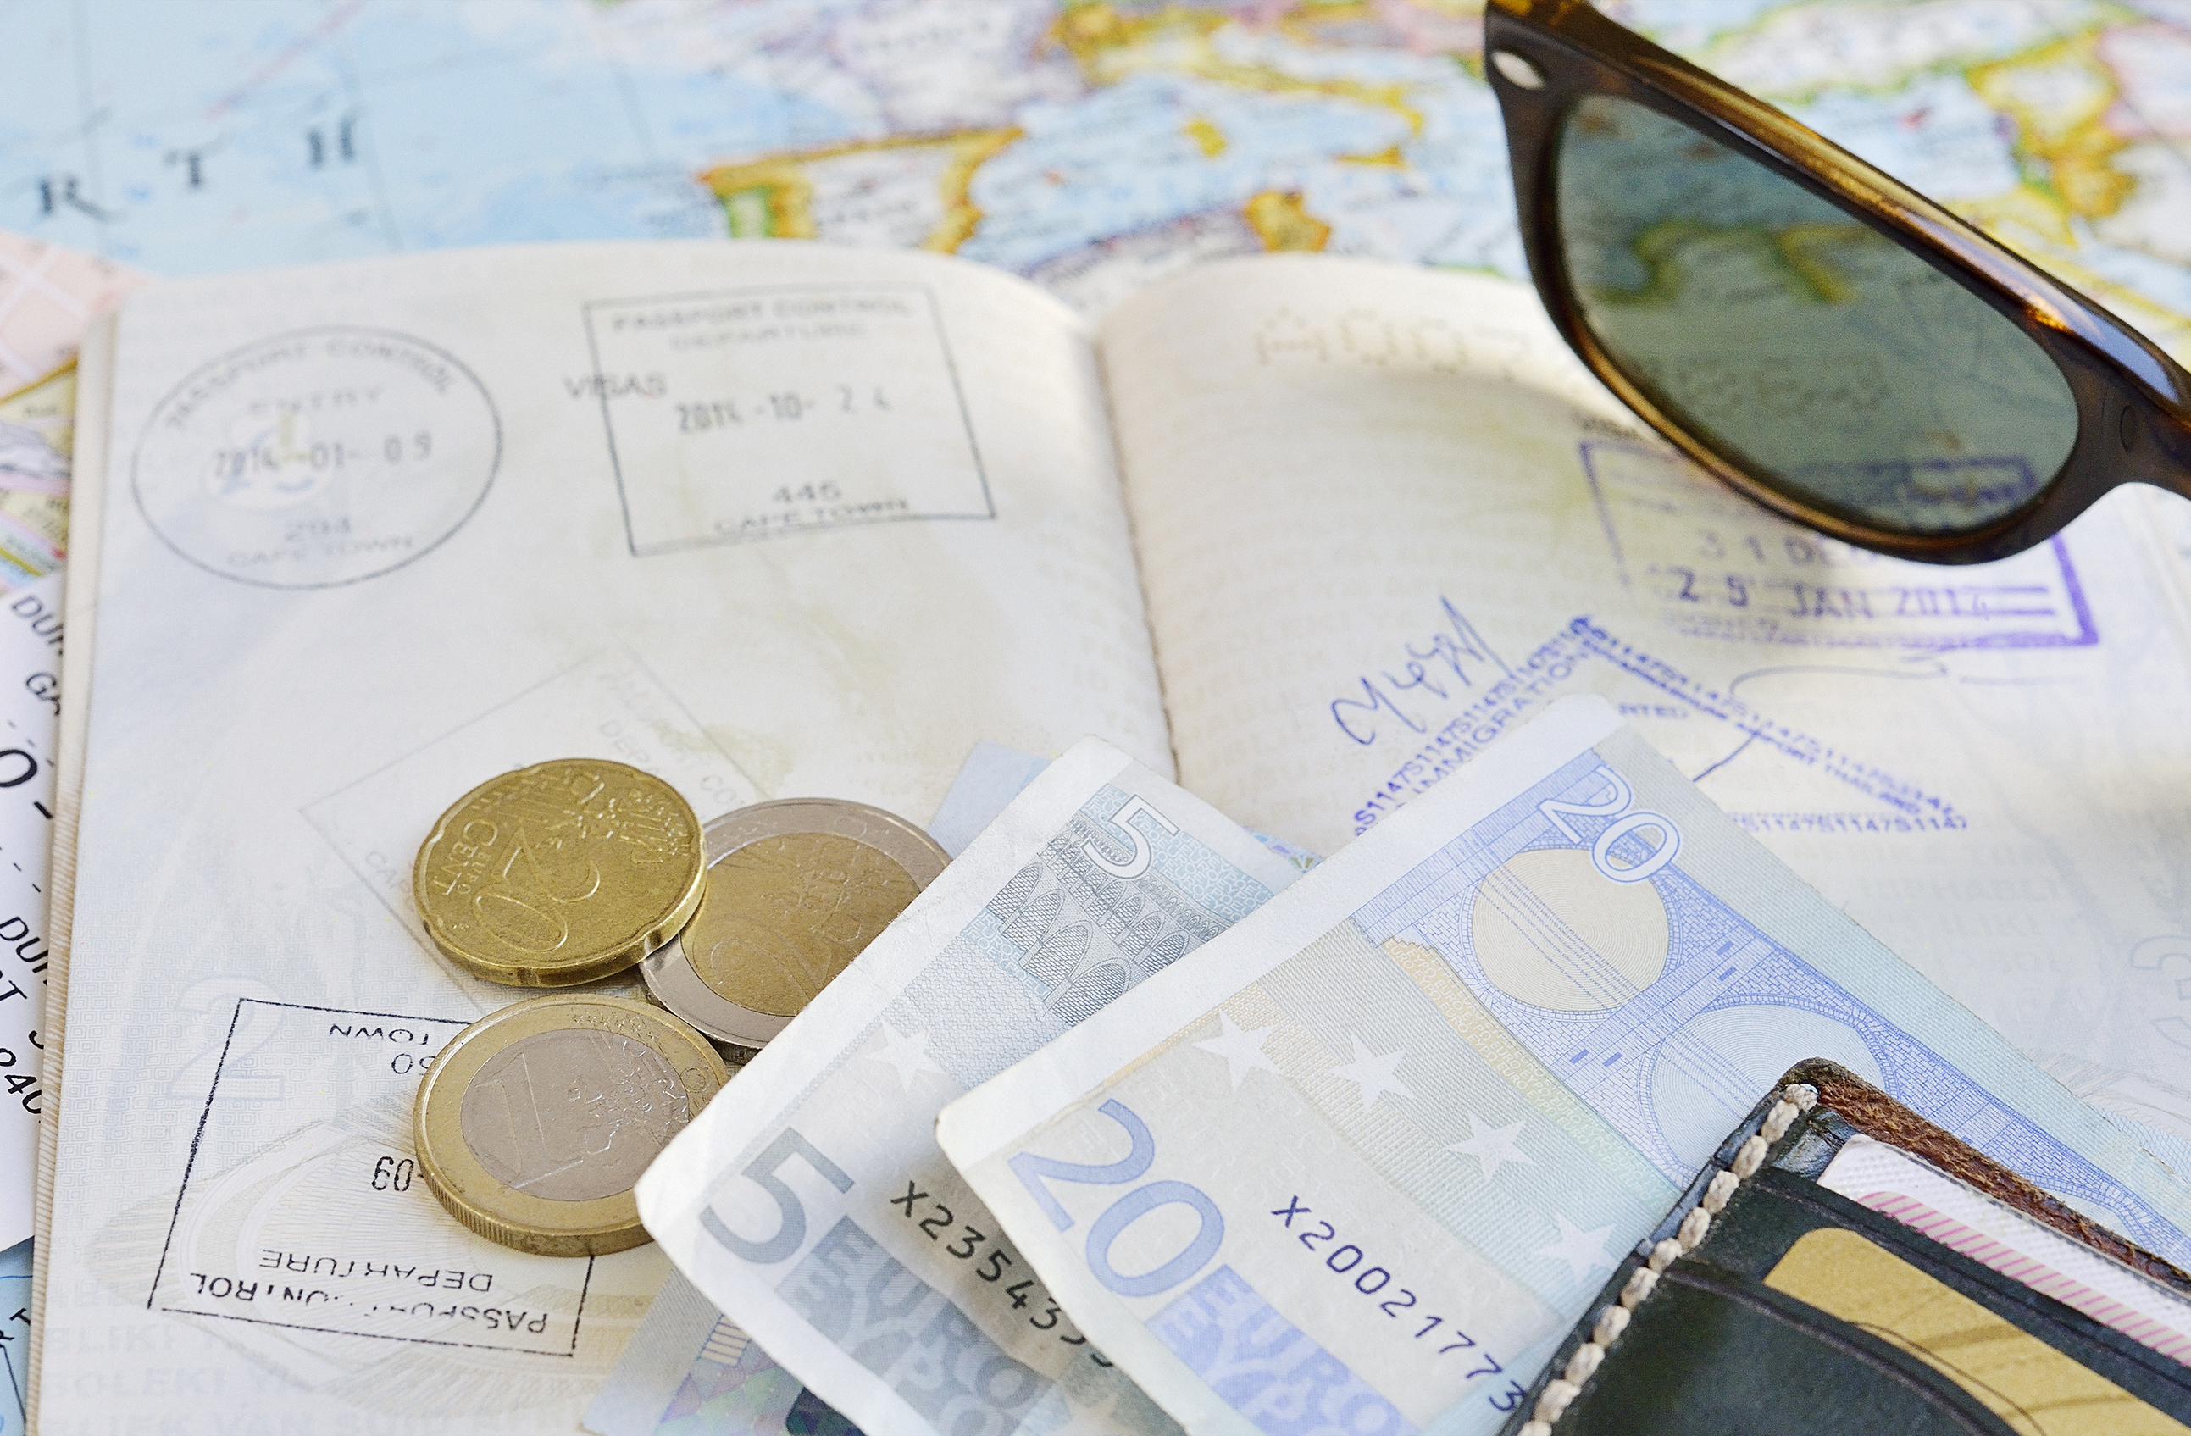
Mapping our objective
Calculus to find spending
Visual display of spending
Warnings and advising

Slide 4

Plans change: Calculator
APIs are tricky
Libraries instead!
ChartJS

Slide 5

Possibilities
Starting from pretty much scratch
More time, more functionalities, i.e.:
Notifications of spending
Breakdowns of expenditures
Implementation of time, more complex display
Filtering and customization

Slide 6
SOURCES
BG Image: https://pixabay.com/photos/wealth-us-dollars-usa-business-69524/
Graph, ChartJS:
https://www.npmjs.com/package/chartjs
https://www.chartjs.org/docs/latest/samples/line/line.html

Slide 7
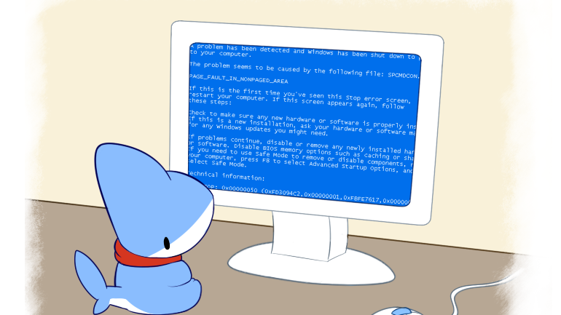
~Fin~

Slide 8
~Stay sase out there~

